Slide 1


Slide 3
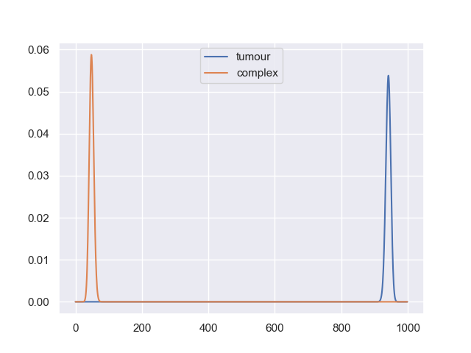
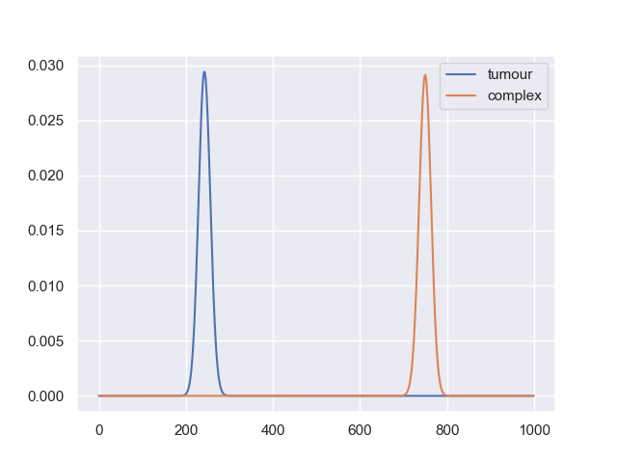
Saturating antibody model binding distributions
A0 = 1e-7
A0 = 1e-5

Slide 4
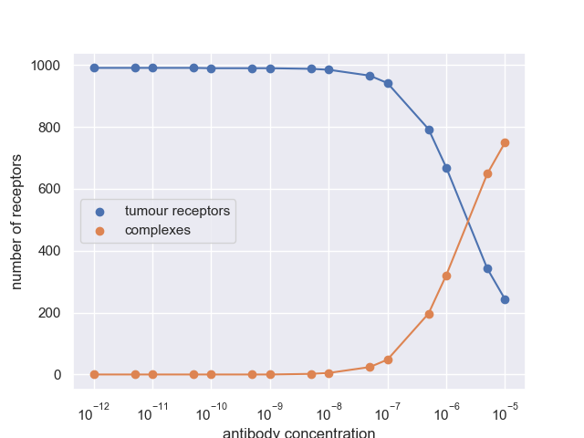
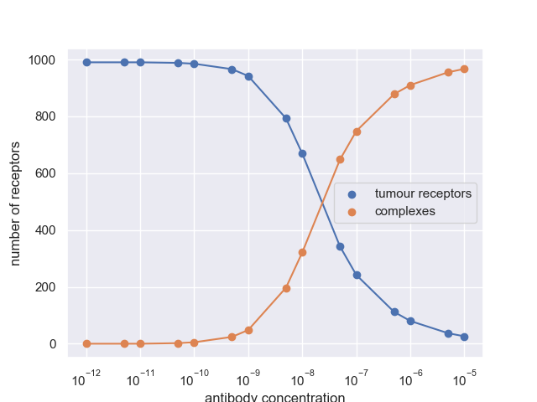
Max number of receptors bound vs ab concentration
qon = 6.5e3
qon = 6.5e5

Slide 5



